Slide 1
13th Session
11th December 2018

Slide 2
Population ageing is unprecedented, without parallel in human history—and the twenty-first century will witness even more rapid ageing than did the century just past.
Population ageing is pervasive, a global phenomenon affecting every man, woman and child—but countries are at very different stages of the process, and the pace of change differs greatly. Countries that started the process later will have less time to adjust.
Population ageing is enduring: we will not return to the young populations that our ancestors knew.
Population ageing has profound implications for many facets of human life.
UN – Population Division, 2002, World Population Ageing: 1950-2050

Slide 3
Population Ageing and the International Financial Markets
Population Ageing
Combination of
Increase in longevity
Decrease in fertility.
Increase in the old-age dependency ratio (nr of people aged 65+/working-age people [15-64])
Increase in the proportion of older workers.

Slide 4
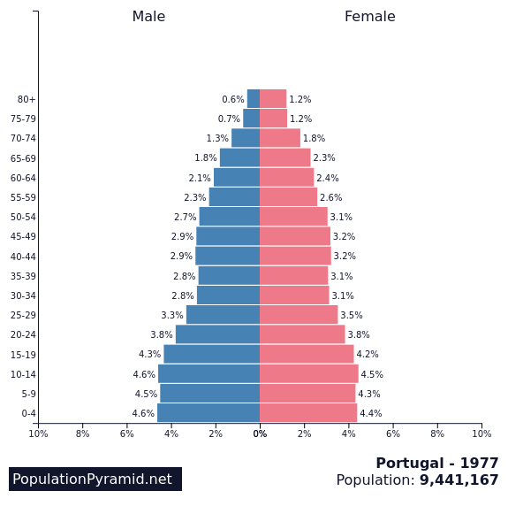
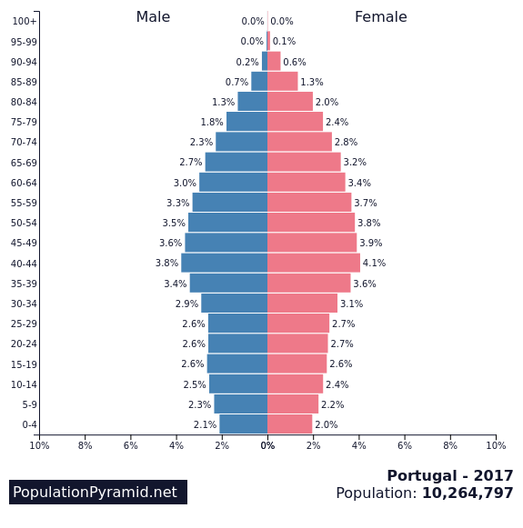
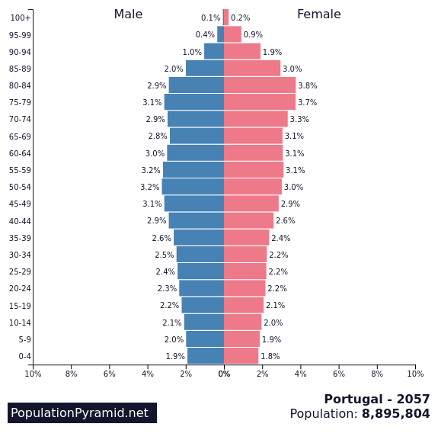
Population Pyramids for Portugal
UN projections for 2057
1977
2017

Slide 5
Macroeconomic implications
Direct effect on Labour Supply.
More indirect effects on
Labour Demand,
Investment,
Productivity,
Consumption,
International Capital Flows
Savings …

Slide 6
Source: Fürnkranz-Prskawetz 2017 Presentation at the 5th IWSEA, ISEG.

Slide 7
Source: Fürnkranz-Prskawetz 2017 Presentation at the 5th IWSEA, ISEG.

Slide 8
Savings
National Saving = Private Saving + Public Saving
Private Saving = business saving + personal saving,
“Personal”: households and nonprofit entities.
Personal saving = personal income - personal spending.

Slide 9
Private Savings
Life Cycle Hypothesis – people smooth their consumption over the lifecycle
Saving rates are expected to increase with the ageing of workers in order to support consumption in the retirement period.
Entering the retirement period, private savings are expected to decrease, with a use of savings built before retirement.
The aggregate saving depends on the proportion of different age cohorts in the population.
These two results assume a life-cycle pattern in savings that is still open to empirical discussion.

Slide 10
Expansion of the Life-cycle model
uncertainty with respect to future income
Bequests

Slide 11
Public savings
Decrease in public savings because of the growth of expenditures with pensions and with health and care (although there is a decrease in the expenditure with education).

Slide 12
Investment
Slower labour force growth→ lower economic growth potential → lower need for Investment, for the same capital to labour ratio.
If technical progress is independent of population growth, the decrease in labour force growth reduces the growth of potential output and, correspondingly, the demand for investment.
Scarcity of labour may stimulate innovation and progress.
Empirical research
Higgins 1998: humped-shaped pattern of the effects of the age structure on the share of investment on GDP, with the peak at 15-24.

Slide 13
What will reduce more: the demand for investment or savings?
At present, the empirical evidence is mixed, very dependent on the samples and on the methodology that are used.
Suppose savings decline more than investment needs:
The investment is not enough to maintain the capital to labour ratio – Per-capita output declines & MPLabour and MPKapital ( i)
Suppose savings decline less than investment needs
The capital to labour ratio increases (K deepening) – Per-capita output may still decline &  MPLabour ( real wages) and MPKapital ( i)

Slide 14
International capital flows
In a phase when the savings in the ageing countries < investment needed in those economies:
There will be an inflow of capital from abroad (decrease in the Net Foreign Asset position*).
*Net Foreign Asset position = Assets hold by residentes in the rest of the world (ROW) – Assets hold by the ROW in the country
In a phase when the savings in the the ageing countries > investment needed in those economies:
Capitals will flow abroad (increase in the Net Foreign Asset position).
Note: assuming that the financial markets are sufficiently developed and that there is security for contracts.
The capital flows will not continue indefinitely because they will lead to adjustments in interest rates.

Slide 15
International capital flows
Liberalization of financial markets – large increase in international capital flows – increased sensitivity to foreign prices and rates of return – correlation between domestic investment and national saving may be weakened.
Necessary to take into account cross-border and cross-currency adjustments to demography and not just domestic adjustments.

Slide 16
If the impact of ageing on savings is larger than the impact on the demand for investment in a certain country
This cannot be true for all the countries in the world at the same time, even if all were experiencing population ageing with the same type of effects. Globally, the changes in flows have to cancel.
Historically, during the last 50 years - downward trends in savings and investment around the world.

Slide 17
Financial Integration
Higher substitutability between assets issued in different countries and between assets denominated in different currencies.
Higher proportion of macroeconomic adjustments based on international transactions and international markets.
Perfect integration – savings in one economy could be invested anywhere in the world. Therefore, in open economies, the correlation between investment and savings is not necessarily high.
However:
Evidence of “home bias”.
The present high level of international capital mobility is more driven by hedging and by risk-sharing among developed countries than by flows of savings from capital-rich to less developed countries.

Slide 18
Financial market asset prices and returns
“Asset meltdown hypothesis” [Poterba (2001)]: as members of the baby boom generation start to enter retirement, they will most likely become net sellers of at least some of the financial assets they have accumulated over their working lives, to support consumption in retirement. They would sell their assets to a smaller generation of investors → downward pressure on financial asset prices

Slide 19
Given increasing longevity and life time uncertainty, decumulation of assets may be slow.
Bequest motive for saving.
Poterba (2004): investidores forward-looking → possible future change in prices caused by demography should be incorporated in prices in advance (if expectations are that the price will decrease one should sell now, which decreases the price immediately).
Assessment of the effects of future demographic developments on prices needs the evaluation of the extent to which investors are forward-looking.

Slide 20
The preference for certain types of assets changes as people age. If these age-related preferences remain constant over time, ageing will affect the asset prices and relative returns of different asset classes.
Demographic ageing → possible change in the relative demand for assets → effect on prices
In principle, middle-age corresponds to the life-cycle period with
Higher saving rate
Lower risk aversion
because, while working, people are better able to make up for any bad equity returns –With a longer time horizon, it is easier to accept risk in exchange for a higher expected return.

Slide 21
Larger proportion of middle-aged workers → Increase in the demand for stocks in comparison with bonds → Increase in the relative price of stocks → Decrease in the return for stocks comparing with that for bonds.
Higher proportion of retired population
Lower saving rate
Higher risk aversion
→ Increase in the relative demand for bonds comparing with stocks → Increase in the relative price of bonds → Decrease in the return for bonds comparing with that for stocks.

Slide 22
Poterba (2001): USA- separating cohort from age effects, he finds that stocks are an increasing fraction of net financial holdings through age 40-44. Then it starts decreasing. If analysing stocks as the fraction of net worth, it increases through ages 55-59 and shows a small decline after that.
Mixed evidence about the relation between the demographic structure and the prices of different financial assets.
Poterba (2004): increased demand for
Annuities, that provide an income stream in old-age,
Long-term care insurance

Slide 23
Conclusions
Ageing population – slower labour force growth or even reduction – lower demand growth or even reduction –lower GDP growth perspectives – reduced need for Investment
Ageing population –reduction in Savings rates if the life-cycle model is right – not necessarily a reduction if there is an increase in Savings to fund longer periods of retirement and if wages raise because of labour scarcity.
In a closed economy- the relation bewteen savings and investment determines real interest rates.

Slide 24
Conclusions (cont.)
In open economies, capital flows to capital markets where returns are higher, particularly in developing regions and emerging economies, where populations are younger - labour productivity will not increase and domestic labour will not benefit with rising wages. Returns on the foreign investments still raise national income.
Ageing affects the market patterns of assets returns and the composition of financial products demanded by the household sector.

Slide 25
Poterba, J. (2001) Demographic structure and asset returns, Review of Economics and Statistics, 83, pp. 565-584.
Poterba J. (2004) The impact of population aging on financial markets, NBER Working Paper No. W10851

